Slide 1
Upper limb Neurological Examination
馬偕醫院神經科
李卓育醫師

Slide 2
自我介紹並解釋檢查目的
確認病人身份
接觸病人前洗手
Inspection
Muscle tone
Muscle power
Deep tendon reflex
Coordination
Sensation
接觸病人後洗手

Slide 3
Inspection
muscle atrophy
fasciculation
involuntary movement

Slide 4
Muscle Tone
spasticity (pyramidal)
rigidity (extra-pyramidal)

Slide 5
Muscle Power Medical Research Council (MRC) scale
0 = no contraction
1 = visible muscle twitch but no movement of the joint
2 = weak contraction insufficient to overcome gravity
3 = weak contraction able to overcome gravity but no additional resistance
4 = weak contraction able to overcome some resistance but not full resistance
5 = normal; able to overcome full resistance

Slide 6
Muscle Power
Pronator drift
Shoulder abduction, elbow flexion, elbow extension, wrist flexion, wrist extension, finger flexion, finger extension, finger adduction, thumb abduction, little finger abduction

Slide 7
如何握神經槌
選擇槌頭重,槌柄長的神經槌
用手指輕握槌柄(掌心不要握實),用手腕的力量很輕快的將槌頭”甩“在受試者肌腱上
重點是下垂的加速度

Slide 8
Reflexes
Grading of reflexes
0 = absent
1+ = reduced (hypoactive)
2+ = normal
3+ = increased (hyperactive), brisk
4+ = clonus

Slide 9
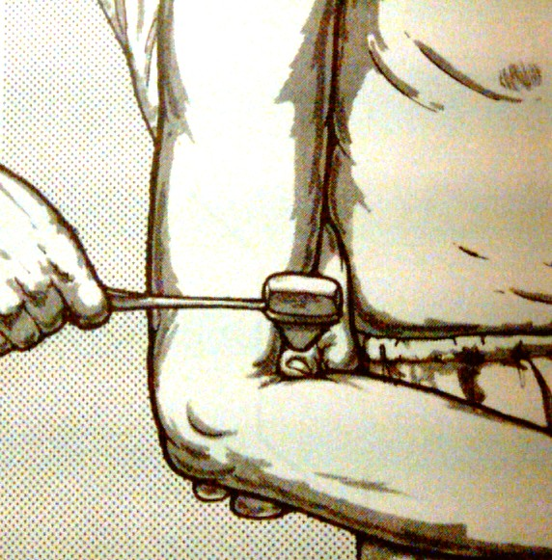
Deep tendon reflexes: 上肢
Biceps stretch reflex
C5C6/ musculocutaneous n.

Slide 10
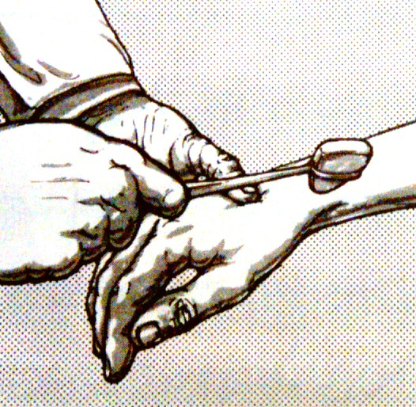
Deep tendon reflexes: 上肢
Brachioradialis stretch reflex
C5C6/ radial nerve

Slide 11
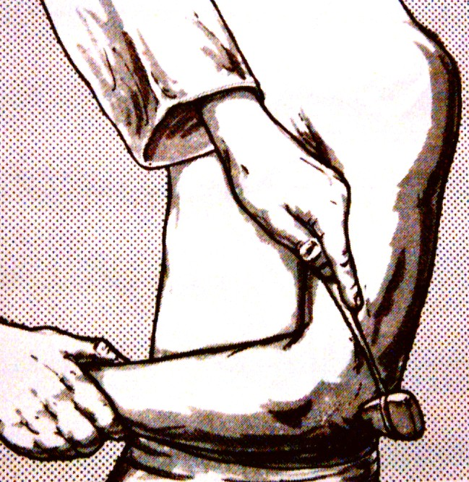
Deep tendon reflexes: 上肢
Triceps stretch reflex
C7C8/ radial nerve

Slide 12
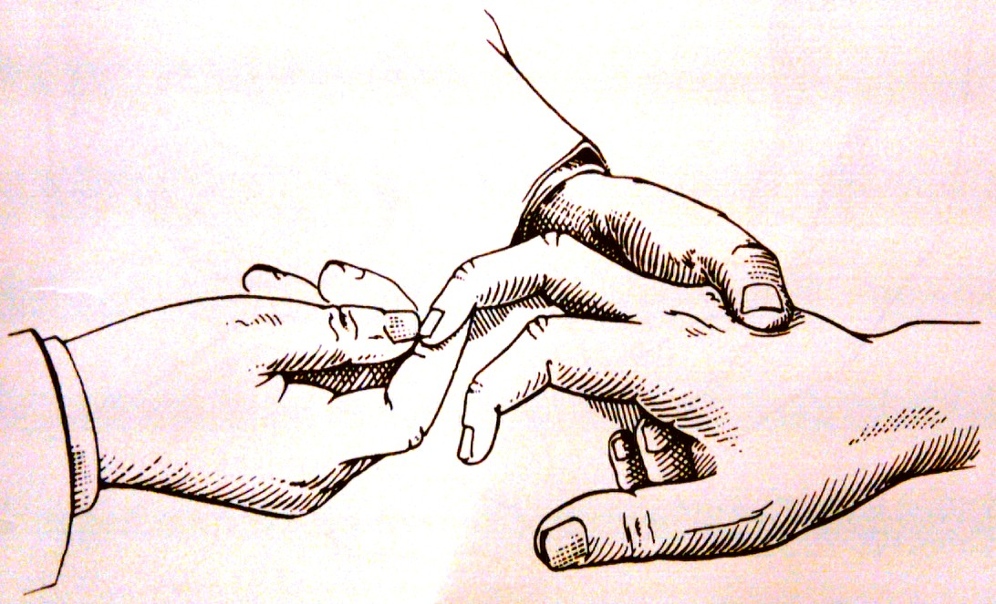
Deep tendon reflexes: 上肢
Hoffman sign
corticospinal dysfunction

Slide 13
Coordination
finger-nose-finger test
rebound phenomenon
rapid alternative movements (dysdiadochokinesia)

Slide 14
Sensation
light touch
Pinprick
Proprioception
vibration (128Hz)

